Slide 1
AWS Redshift Serverless
Prepared by Mohammed Sayeeduddin

Slide 2
Introduction
Amazon Redshift enables you to run analytics for your business without having to provision servers or infrastructure, making it easy to get started. It includes a web-based query editor in the AWS console to start loading and analyzing your data without having to install software. Amazon Redshift is also compatible with your favorite query editors like DBeaver, SQL WorkbenchJ, and Toad using Java Database Connectivity (JDBC) or Open Database Connectivity (ODBC) drivers provided.

Slide 3
Meaning of Redshift
The term was coined based on the astronomical phenomenon Red Shift, which is a concept in physics for astronomers. It means the wavelength of light is stretched as it expands, so the light is shifted toward red, the color at the longest wavelength end of the visible spectrum of light.

Slide 4
AWS Redshift
Because data is ever expanding, Amazon Redshift provides a platform to store and analyze data and scale it seamlessly. Being the first fully managed, PB-scale cloud data warehouse, Amazon Redshift is an architectural shift from on-premises data warehousing solutions, which require upfront capital investment, effort to scale, and full-time resources to operate.
Amazon Redshift data warehouse service is ANSI SQL compatible and built for OLAP workloads that store your data in compressed columnar format. This service is available as a provisioned or serverless data warehouse.

Slide 5
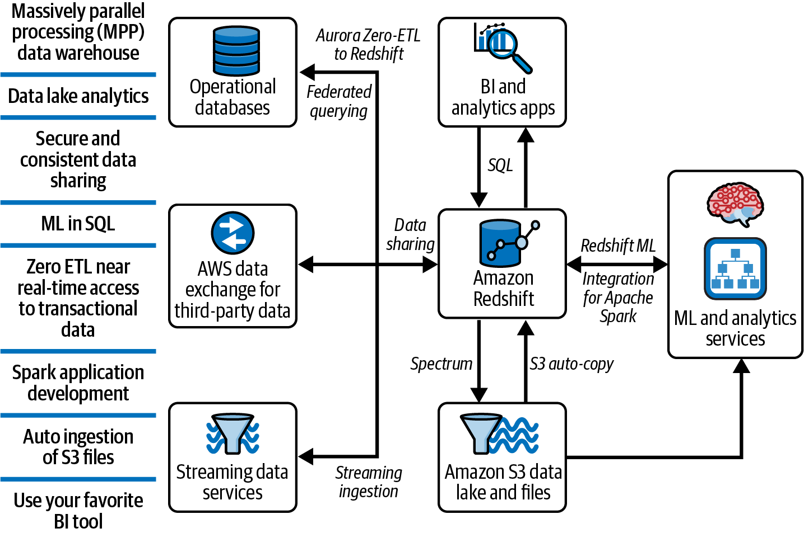
Diagram

Slide 6
Auto-scaling
The serverless architecture automates many of the operational activities to monitor and scale Amazon Redshift. Amazon Redshift serverless leverages a machine learning-based workload monitoring system to automatically scale compute resources to meet the demands of your workload. Also, as your demand evolves with more concurrent users and new workloads, your data warehouse scales automatically to provide consistent query execution times.

Slide 7
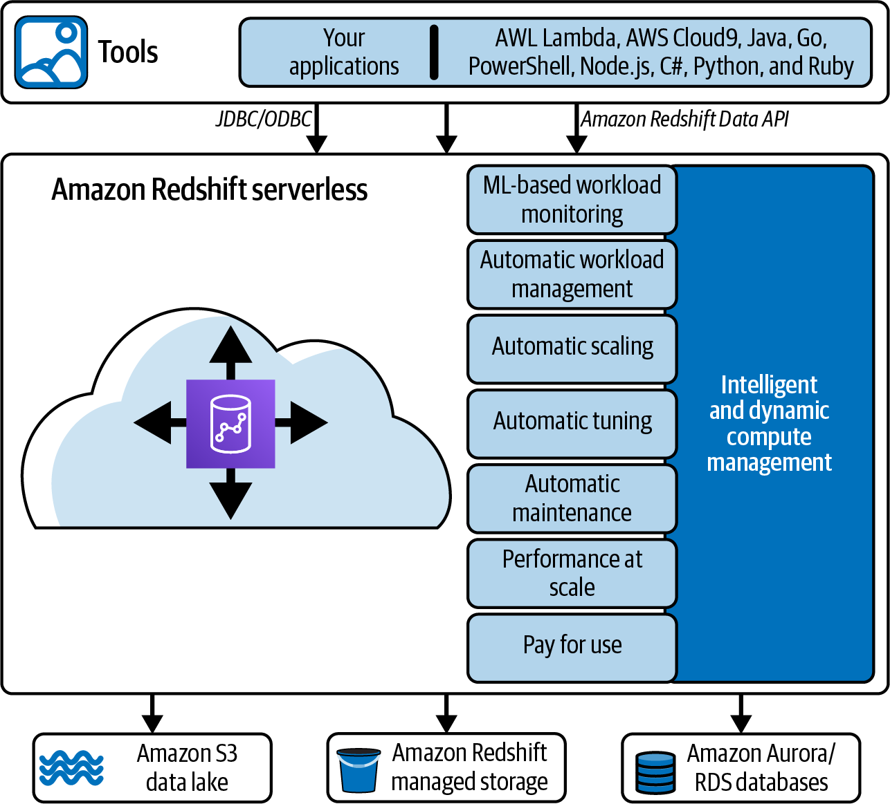
Data flow

Slide 8
Creating an Amazon Redshift Serverless Data Warehouse
Amazon Redshift serverless is separated into workgroups and namespaces to manage storage and compute resources separately.
The namespace is a collection of database objects that include databases, schemas, tables, users, user permissions, and AWS Key Management Service keys for encrypting data. Other resources grouped under namespaces include datashares, recovery points, and usage limits.
The workgroup is a collection of compute resources and include Amazon RPU base capacity, virtual private clouds (VPC) subnet groups, security groups, and limits.

Slide 9
Amazon Redshift Data API
Another way to connect to Amazon Redshift and query data is by using the Amazon Redshift Data API (Figure 2-27). Using this strategy, a user does not connect directly to Amazon Redshift but instead connects to a secure HTTP endpoint. You can use the endpoint to run SQL statements without managing connections.

Slide 10
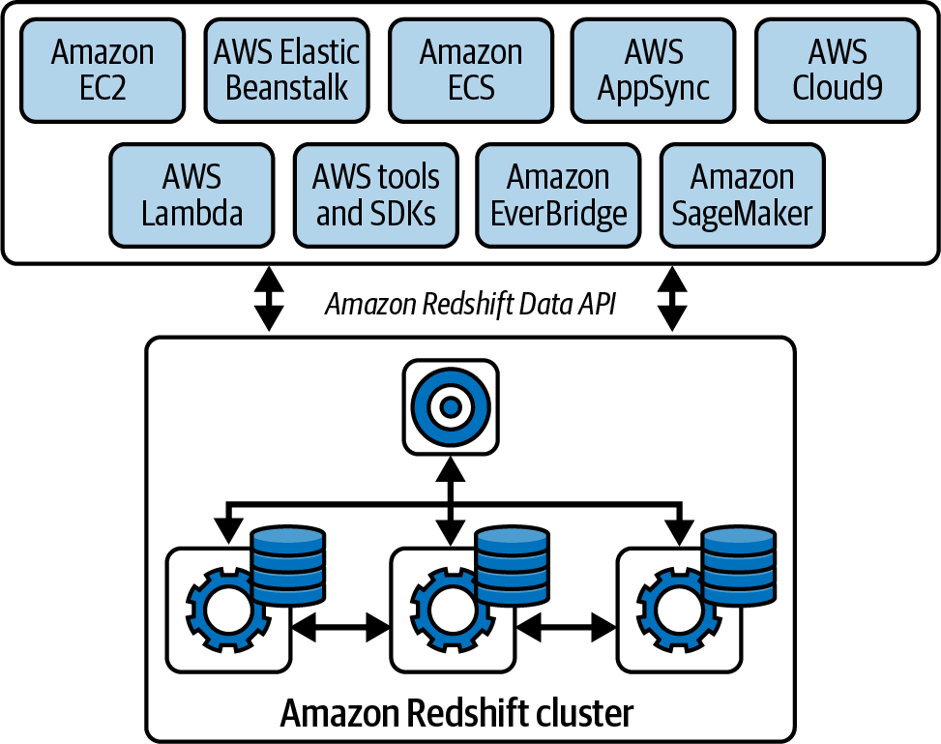
Redshift API Diagram

Slide 11
Creating an Amazon Redshift Serverless Data Warehouse
Amazon Redshift serverless is separated into workgroups and namespaces to manage storage and compute resources separately.
The namespace is a collection of database objects that include databases, schemas, tables, users, user permissions, and AWS Key Management Service keys for encrypting data. Other resources grouped under namespaces include datashares, recovery points, and usage limits.
The workgroup is a collection of compute resources and include Amazon RPU base capacity, virtual private clouds (VPC) subnet groups, security groups, and limits.

Slide 12
step1
To deploy an Amazon Redshift serverless data warehouse using the AWS console, navigate to the Create Workgroup page and choose your configuration options. In the first section, you will choose the workgroup name. Next, you will decide the initial compute capacity by choosing the base RPU capacity. This is the compute capacity used when Amazon Redshift serverless starts processing your workload, but it can scale up automatically based on your workload needs. You can choose a little as 8 RPUs or as many as 512 RPUs with a default of 128. For more details on determining the best RPU size for your use case

Slide 13
step2
If creating a new namespace, you will be prompted to specify the permissions and admin credentials (Figure 2-5). Similar to a provisioned cluster, permissions are defined via Identity and Access Management (IAM) roles the workgroup can assume to access other resources within your AWS environment. In the next example, we created an IAM role RedshiftRole, assigned it the AmazonRedshiftAllCommandsFullAccess policy, and made it the default.

Slide 14
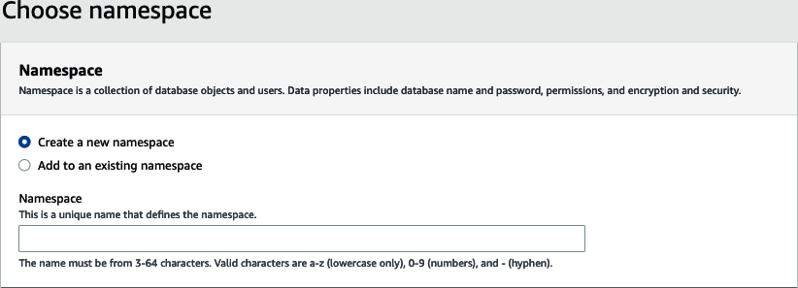

Slide 15
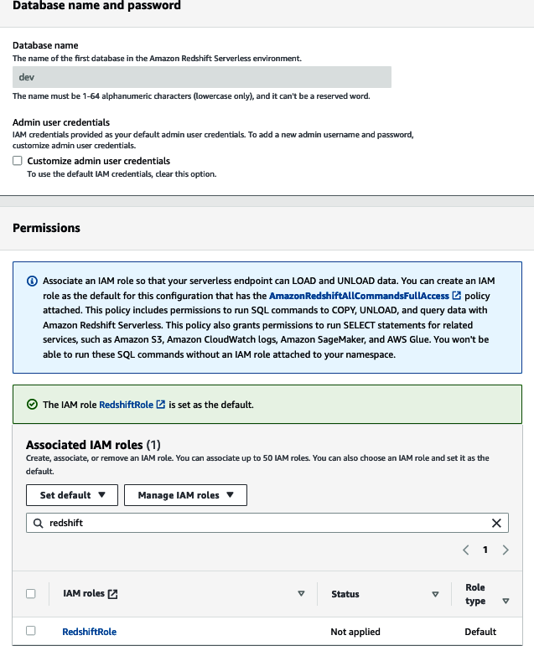
database

Slide 16
Permission

Slide 17
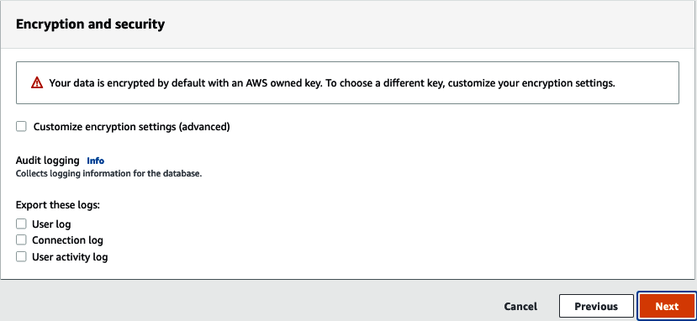
Final step
Finally, for your new namespace, specify if you would like to customize the encryption and logging

Slide 18
Sample Data
Activate Sample Data Models and Query Using the Query Editor
Hands on ..with prewritten queries
Sample:
SELECT e.eventname, total_price
FROM (
SELECT eventid, sum(pricepaid) total_price
FROM tickit.sales
GROUP BY eventid) Q, tickit.event E
WHERE Q.eventid = E.eventid
QUALIFY ntile(1000) over(order by total_price desc) = 1
ORDER BY total_price desc;

Slide 19
sample2
SELECT sum(qtysold)
FROM tickit.sales, tickit.date
WHERE sales.dateid = date.dateid
AND caldate = '2008-01-05';

